Slide 1
Biol 7200: Programming for Bioinformatics Week 1 demos and broken code

Slide 2
Some options for the same task – line endings
file
cat –e

Slide 3
Some options for the same task – check whitespace
cat –A # same as cat –vET or -et
grep –P ‘\t’ <file> | wc –l; grep ‘ ‘ | wc -l

Slide 4
Some options for the same task - Replace windows line endings
dos2unix
tr –d ‘\r’ < ex1.bed
Sed ‘s/\r//’ ex1.bed

Slide 5
Demos – Q8.6 (extra credit)
Only volunteer answers using bash commands (no python scripts)

Slide 6
Demo solutions
awk '{$4=$3-$2; print}' ex1.bed | sort -k4nr | head -1
awk 'BEGIN {maxdiff = 0; largest = "";} {difference = $3-$2; if (difference > maxdiff) {maxdiff = difference; largest = $0; }} END {print largest}' ex1.bed

Slide 7
Broken code - How will this work?
For each example
Someone will be selected
Raise your hand to volunteer (if you have prior experience, please wait for later weeks!)
I’ll pick someone
State what the (hypothetical) person writing the code is trying to do
State why it doesn’t work
State how to fix it
Answer questions
I’ll tick your name off the list, and you have satisfied your demo requirement
If you get it right, or close enough (at my discretion)
If you get it wrong, you can try again another week. You get two chances

Slide 8
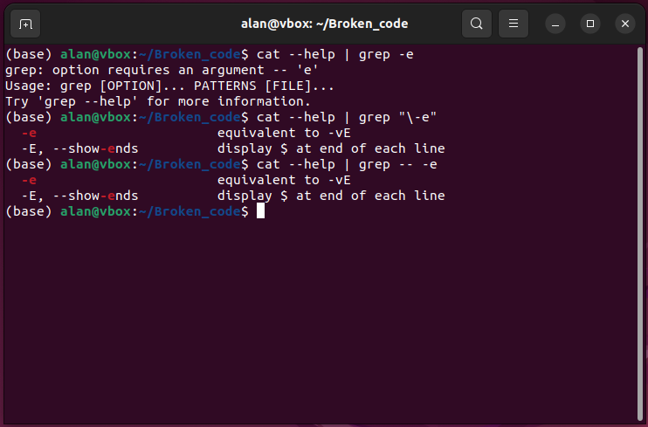
Broken code 1
What is it trying to do?
grep a help message for the “-e” option
Why doesn’t it work?
grep interprets the “-e” as an option not a pattern
How can we fix it?
Escape the “-” with a “\” or use “--” to indicate no more options

Slide 9
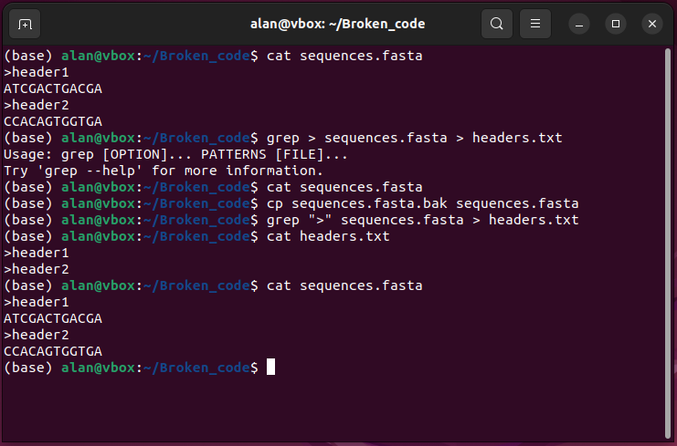
Broken code 2
What is it trying to do?
Extract headers from a fasta file by searching for lines containing “>”
Why doesn’t it work?
Your shell interprets the “>” as a stdout redirect
grep is run without a pattern, which is required input, so sends and error to stderr and nothing to stdout
The empty stdout from grep is directed to sequences.fasta, overwriting it
How can we fix it?
Protect the “>” from interpretation by your shell using quotes

Slide 10
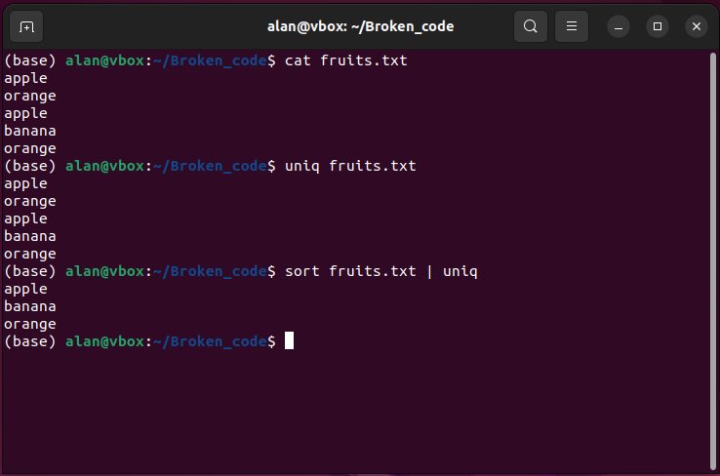
Broken code 3
What is it trying to do?
Identify just the unique lines in the file
Why doesn’t it work?
uniq requires sorted input
How can we fix it?
sort the file then pipe to uniq

Slide 11
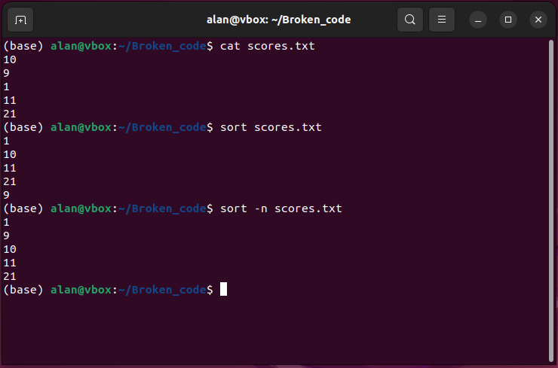
Broken code 4
What is it trying to do?
Sort numbers in the file
Why doesn’t it work?
sort default is alphabetical sort
How can we fix it?
sort using “-n” for numerical sort

Slide 12
Back to the lecture

